Slide 1
H&M Personalized Fashion Recommendations

Slide 2
Objectives
Objective of this project is to give personalized fashion recommendations to its customers based on their recent or last transactions using machine learning models. To present a recommendation system which gives recommendation based on last transactions of the customers given in the dataset of H&M Personalized Fashion Recommendation.

Slide 3
Benefits
We can reduce this time spent by using recommendation systems
Personalized Recommendations help in keeping the customer happy, which in turn helps organizations in selling products and services.
Product discovery
Recommendation engines produce reports about the products on the website.
Customer Satisfaction- The recommendation engine will most likely suggest the previously viewed products, and the customer will end up buying them without much effort.
Increase in Revenue- When product sales and customer satisfaction increases, it positively affects the organization’s revenue.

Slide 4
Data Sharing Agreement
Data-
articles.csv
customers.csv
transactions_train.csv
sample_submissions.csv
Column names- article_id, prod_name, product_type_no, sales_channel_id,color, customer_id, transaction_id, date, etc.

Slide 5
Architecture
Training/Validation on data
ML model for Recommendation
Take the data from sensors
Recommendation result
Take the necessary action

Slide 6
Data pre-processing and EDA
Cleaning, transforming, and integrating of data in order to make it ready for analysis. The goal of data preprocessing is to improve the quality of the data and to make it more suitable for the specific columns just needed for the project.
Also I first displayed the data to see the various contents of dataset. Then dropping values which ere not required for this project. Finding out null values and filling them out.
There were three datasets in total on which I had to work on. So, reviewing them one by one was quite a tedious task also the amount of data was huge. It was necessary to preprocess it.
By exploring the data we come across various columns and rows of like age, product data, customer data, etc.
Selection of only important parameters was done and unnecessary data or columns were dropped.

Slide 7
Step-1
I first tried to find out if there are any relations between them as the ratings of the product were not given it was quite hard to finally find any relation which will give the expected output.
Every parameter took was sparse and therefore haven't shown any kind of relation with other parameters.
Grouping various columns together to find out the exact relation on which our model will be based on was a time consuming task
Transactions dataset gave some hints with respect to the relations between the columns. The customers with high frequency of shopping were put together and their graph was plotted which gave the number of transactions each day

Slide 8
Step-2
Finding the total sales for each month in 2018 and 2018 comprised of the date, month and the total sales which happened during that month
We did this by plotting table to be specific a pivot table was plotted which gave a month by month comparison
Transaction data was then displayed which had cleaned data and their graphs were plotted- month value counts and also articles value count was also done on the basis of thises grapghs

Slide 9
Step-3
By applying different axis on the images dataset I was able to get the images as well as their prices while running the machine learning model.
Further modifications were done which also helped to get the items frequently bought together along with their customer ids and images as well.

Slide 10
Web Page of Recommendations
Next came the part which was the most difficult one connecting the html file which the python code of machine learning was really challenging .
I used Flask in python with the help of rendering template the html file was connected which gave us the results.
Designing the web page was interesting and also executing it , when we type in the recommendations for shirt it displays the generated output

Slide 11
Frequent Q&A
Q) What is the source of the data?
Data was collected from Kaggle, but the data was really huge so there was no option rather than just to run the machine learning codes there itself.
Q) What techniques were you using for data pre-processing?
In data pre processing, we analyzed the data, found the important features, and based on the domain knowledge, we eliminated the unnecessary columns. We also tried to fill Missing Values with mean, median and mode but still the data have the same correlations. Thus removing the columns with high NaN values was the better option for us.

Slide 12
Frequent Q&A
Q) How did you choose the model?
After implementing hyper parameter tuning, we were able to do model selection based on the metrics and how it was performing on unseen data.
Q) For will this project be useful?
The customers who are frequent buyers for them this will be helpful as they wont need to browse through different products not as per their liking.

Slide 13
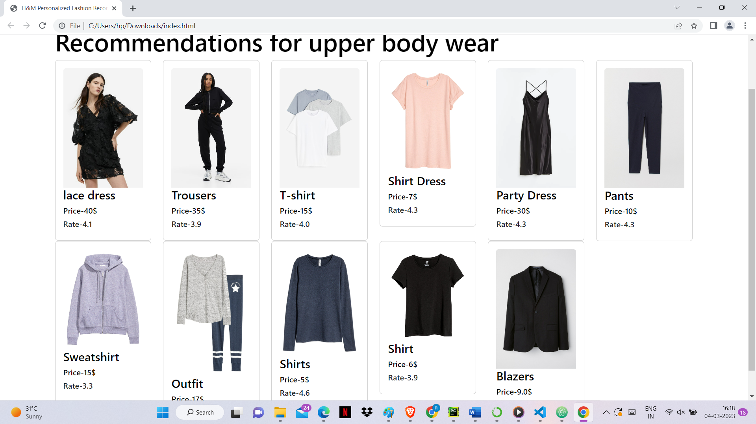
Picture of the Recommendations

